Slide 1



ROMANIA
MINISTRY OF NATIONAL DEFENSE
“Carol I” National Defense University
Regional Department
of Defense Resources Management Studies
- DRESMARA -
Notes:
Allow me to briefly present you the Regional Center of Defense Resources Management and the activity of our personnel.

Slide 2

BACKGROUND
Strategic Partnership Romania – USA
Set up by Romanian Government decision no. 466 from 06/10/1999, in cooperation with Defense Resources Management Institute, Monterey, USA

Slide 3




SUBORDINATION
DEFENCE STAFF
“Carol I” National Defense University
REGIONAL DEPARTMENT
OF DEFENSE RESOURCES MANAGEMENT STUDIES
NATO Partnership Training and Education Center (2007)
Member of The Academy of Romanian Scientists (2017)

Slide 4
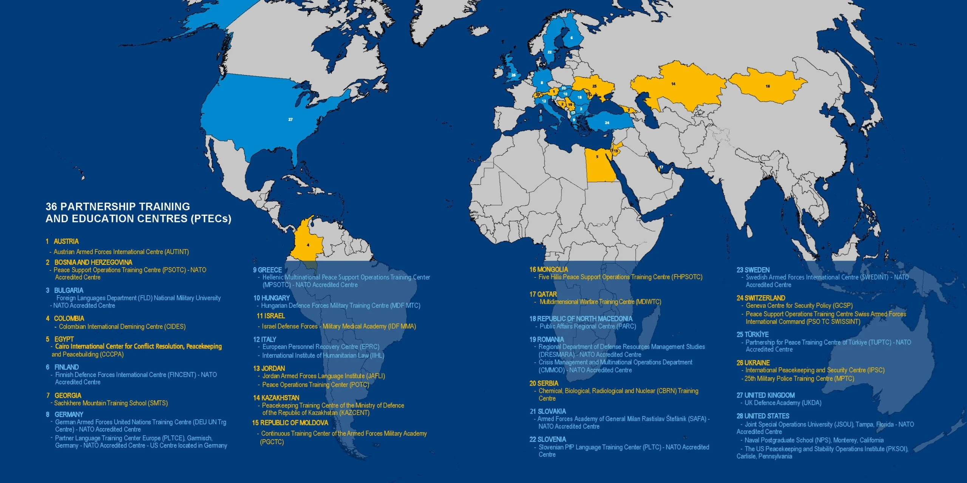
Decision of the Political–Military Steering Commitee on Partner for Peace
no.EAPC/PFP(PMSC)R(2007)0010 from 18.05.2007
https://www.act.nato.int/our-work/partnership-training-and-education-centres/

Slide 5
OUR VISION
The Regional Department for Defense Resources Management Studies is recognized both nationally and internationally for EXCELENCE in providing education and DEVELOPMENT of fundamental though patterns based on integrated-adaptive and creative-intuitive models, achieved through educational programs dedicated to current and future leaders, both military and civilian with roles in the implementation of the National Security Strategy.
Our vision is built on our values:
1. DEDICATION built on force, passion, self-betterment, trust, friendship and tolerance;
2. AUTHENTICITY acquired through quality, responsibility, integrity, ethics, discernment, thoroughness;
3. PROGRESS ensured by strategic thinking, continuous communication, team work, consensus, constant change and modernization.

Slide 6

We built OUR VISION on our values:

Slide 7


OUR MISSION
Developing knowledge and improving the skills of military and civilian personnel,
Romanian and foreign, in the fields of:
      Defense Resources Management
      - Information Resources Management

Slide 8
OBJECTIVES
To provide educational programs in defense resources and information systems management for Romanian and foreign military and civilian personnel with or about to fill in high positions.
To ensure understanding of defense resources and information systems management concepts and decision-making techniques as they apply to optimal allocation and efficient utilization of resources within contemporary defense organization.
To conduct scientific research in defense resources management by studying and adapting modern managing methods and techniques to the needs of the military organization.
To organize, hold or host NATO /international /national conferences, symposia, scientific sessions, workshops, courses or exercises.

Slide 9
ORGANIZATIONAL CHART
DIRECTOR
Department of Management
Finance-Accounting
Structure
Security
Structure
Education Support Service
Postgraduate School of Studies
Education Planning, Secretariat, PR, International Relations Office
Staff, Admin and Procurement Office
IT Compartment
Master program
Postgraduate courses
BI-IAP
BI
HRM
STUDENTS
Seats > 400/Year
NATO ACT
CODING

Slide 10
Defense Resources Management
FACULTY
Professors
Associate Professors
Lecturers
Junior Lecturers
Military Instructors
- PhD - 6
- all teachers have graduated
specialization courses abroad
Teaching Staff
positions and
qualifications:
over 30 Romanian experts per academic year from education entities and other military or civilian structures;
over 15 foreign experts per academic year from NATO structures, education entities or other military or civilian organizations
Guest speakers:

Slide 11







Slide 12





ACCREDITATIONS
- HIGH CONFIDENCE DEGREE – ARACIS (Romanian Agency for Quality Assurance in Higher Education), 2021-2026
- INSTITUTIONAL EVALUATION PROGRAMME - IEP 2013
„UNCONDITIONAL ACCREDITATION”
2015-2021, JFT/ACT accreditation
2022-2028, JFD (current MDFD)/ACT reaccreditation (October 2021) – one out of the 12 accredited PTECs

Slide 13
EDUCATIONAL OFFER
ACADEMIC PROGRAMS
1. MASTER OF SCIENCE – Organization’s Resources Management (in Romanian)
2. POSTGRADUATE COURSES (in English):
2.1 For Senior Officials:
1. Defense Resources Management (DRMSO) - ACT.678. (BI)
2. Information Resources Management (IRMSO) - ACT.679. (BI)
2.2 For Experts:
3. Defense Resources Management (DRMEX) - ACT.715. (BI)
2.3 Specialization:
4. Planning, Programming and Budgeting of Defense Resources (PPBDR) - ACT.676. (ETEE)
5. Project and Program Management (PPM) - ACT.677. (BI)
6. Information Security Management (ISM) - ACT.675. (CO)
All courses are certified at the highest level of the North Atlantic Alliance – “NATO APPROVED” and are aligned with the following NATO disciplines: Building Integrity (BI), Cyberspace Operations (CO) and Education, Training, Exercises and Evaluation (ETEE)

Slide 14
ACADEMIC PROGRAMS
3. Building Integrity Institutional Enhancement Course: Human Resources Management Course (BIHRM) ACT.888. and Building Integrity Institutional Enhancement Course: Integrity Action Plan (BI-IAP) ACT.935.
in cooperation with Center for Integrity in the Defense Sector (CIDS) – Norway (Department Head/Buiding Integrity)
with support of NATO IS/Operations Division/Defence Institution & Capacity Building Directorate and NATO IMS
alinged at Building Integrity NATO Discipline
certification: NATO APPROVED
open to: NATO, PfP, MD, ICI and Pat.G.
target audience: Military and civilian personnel in defense institutions working with integrity and policy development, including decision making related to Human Resources Management, personnel occupying similar positions in civilian organizations

Slide 15



COURSE CERTIFICATIONS
DRMSO, IRMSO, DRMEX and ISM postgraduate courses - certified “NATO APPROVED” by JFT/ACT (since 2017)
PPBDR and PPM postgraduate courses - recertified “NATO APPROVED” by JFD/ACT (in 2021)
BIHRM course - certified “NATO APPROVED” by JFD/ACT (in 2021)
BI-IAP course - certified “NATO APPROVED” by JFD/ACT (in 2023)
- Satisfy NATO E&T Requirements
- Delivered by a NATO accredited ETF

Slide 16
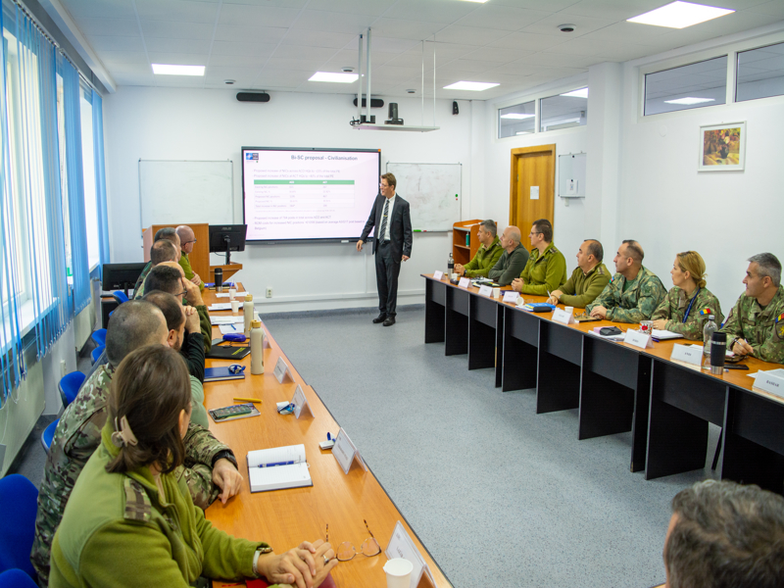
Defense Resources Management for Senior Officials
Postgraduate Course - ACT 678
Student Criteria:
1. Senior defense officials - officers / civilian personnel - in charge with resource allocation and use
2. Lieutenant - Colonel/Commander or higher and equivalent for civilian
Goal:
To improve participants’ skills and knowledge in order to apply concepts, techniques, and analysis of comparative resources management in defense resources allocation and use.
Course Duration: 8 weeks
Curriculum:
Defense Resources Management
Decision Making Theory
Human Resources Management
Information Resources Management
Financial and Economical Management
Logistic Management
Managerial Communication

Slide 17
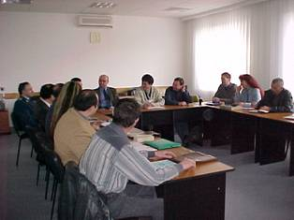
Defense Resources Management for Senior Officials
Postgraduate Course
Curriculum:
Defense Resources Management
Decision Making Theory
Human Resources Management
Information Resources Management
Financial and Economical Management
Logistic Management
Managerial Communication
Course Duration: 8 weeks

Slide 18
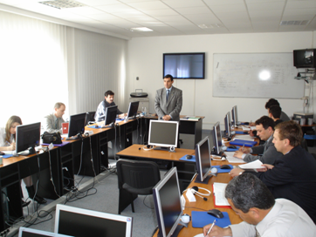
Information Resources Management
for Senior Officials Postgraduate Course - ACT 679
Student Criteria:
1. Officers or civilian personnel from defense, public order and national security and other ministries and agencies in charge with information resources management.
2. Lieutenant Colonel /Commander and equivalent for civilian
Goal:
    To improve participants’ knowledge and skills to lead organization as a successful enterprise, capable of strategically managing complex information resources.
Course Duration: 8 weeks
Curriculum:
Policy and Fundamental Principles of Information Resources Management
Re-engineering of Informational Processes
Enterprise Architecture
Strategic Planning of Information Resources
IT Project Management
Measuring Organizational Performance
Information Assurance
Managerial Communication

Slide 19
2. Information Resources Management for Senior Officials Postgraduate Course
- accredited as “NATO APPROVED” -
(ePRIME and ETOC listed) ACT 679
Student Criteria:
1. Officers or civilian personnel from defense, public order and national security and other ministries and agencies in charge with information resources management.
2. Lieutenant Colonel /Commander and equivalent for civilian
    Goal:
    To improve participants’ knowledge and skills to lead organization as a successful enterprise, capable of strategically managing complex information resources.

Slide 20
Information Resources Management
for Senior Officials Postgraduate Course
Curriculum:
Policy and Fundamental Principles of Information Resources Management
Re-engineering of Informational Processes
Enterprise Architecture
Strategic Planning of Information Resources
IT Project Management
Measuring Organizational Performance
Information Assurance
Managerial Communication
Course Duration - 8 weeks

Slide 21
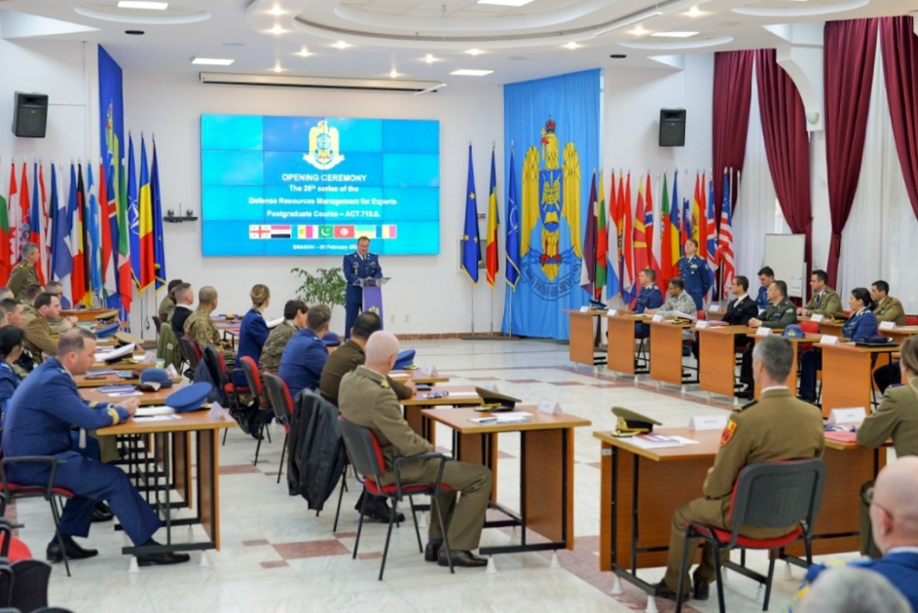
Defense Resources Management for Experts Postgraduate Course
- ACT 715
Student Criteria:
1. Defense experts in charge with resource allocation and use
2. Major /Lieutenant Commander and equivalent for civilian
Goal:
To improve participants’ skills and knowledge by putting in practice concepts, techniques, and analysis of comparative resources management in defense resources allocation and use.
Course Duration: 8 weeks
Curriculum:
Defense Resources Management
Decision Making Theory
Human Resources Management
Information Resources Management
Logistic Management
Financial and Economical Management
Managerial Communication

Slide 22
3. Defense Resources Management
for Experts Postgraduate Course
- accredited as “NATO APPROVED” -
(ePRIME and ETOC listed) ACT 715
Student Criteria:
1. Defense experts in charge with resource allocation and use
2. Major /Lieutenant Commander and equivalent for civilian
Goal:
To improve participants’ skills and knowledge by putting in practice concepts, techniques, and analysis of comparative resources management in defense resources allocation and use.

Slide 23
Defense Resources Management for Experts Postgraduate Course
Curriculum:
Defense Resources Management
Decision Making Theory
Human Resources Management
Information Resources Management
Logistic Management
Financial and Economical Management
Managerial Communication
Course Duration - 8 weeks

Slide 24
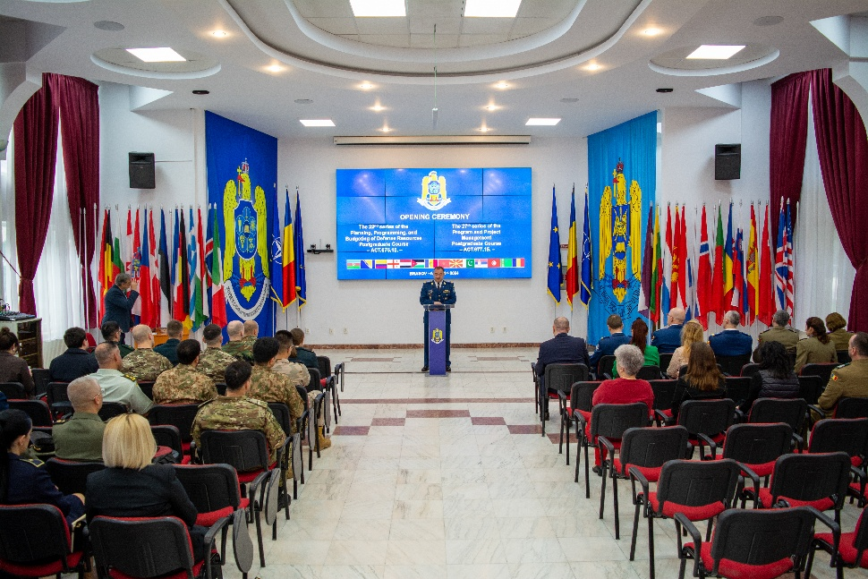
Planning, Programming and Budgeting of Defense
Resources (PPBDR) Postgraduate Course - ACT 676
Student Criteria:
Officers and civilian personnel in charge with resource allocation and use, including logistics, human resources, procurement, financial management, and related fields
Goal:
To acquire and develop major concepts, competences and skills of planning, programming, budgeting and evaluation.
Course Duration: 4 weeks
Curriculum:
Defense planning
Budgeting Systems
Planning, Programming, Budgeting and Evaluation System
Project and program management (economic-financial projects)

Slide 25
4. Planning, Programming and Budgeting
of Defense Resources (PPBDR)
Postgraduate Course
- accredited as “NATO APPROVED” -
(ePRIME and ETOC listed) ACT 676
Student Criteria:
Officers and civilian personnel in charge with resource allocation and use, including logistics, human resources, procurement, financial management, and related fields
Goal:
To acquire and develop major concepts, competences and skills of planning, programming, budgeting and evaluation.

Slide 26
Planning, Programming and Budgeting of Defense Resources (PPBDR)
Postgraduate Course
Curriculum:
Defense planning
Budgeting Systems
Planning, Programming, Budgeting and Evaluation System
Project and program management
(economic-financial projects)
Course Duration - 4 weeks

Slide 27
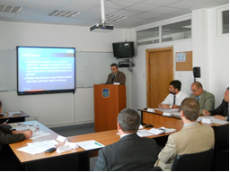
Project and Program Management
Postgraduate Course - ACT 677
Student Criteria:
Officers and civilian personnel in charge with project and program management and related fields
Goal:
To enhance participants’ knowledge, competence and skills in program and project management
Course Duration: 4 weeks
Curriculum:
1. Project and Program management
2. Project Management Software
3. Management of Romanian and International Financed Projects
4. Managerial Communication

Slide 28
5. Project and Program Management
Postgraduate Course
- accredited as “NATO APPROVED” -
(ePRIME and ETOC listed) ACT 677
Student Criteria:
Officers and civilian personnel in charge with project and program management and related fields
Goal:
To enhance participants’ knowledge, competence and skills in program and project management

Slide 29
Project and Program Management
Postgraduate Course
Curriculum:
1. Project and Program management
2. Project Management Software
3. Management of Romanian and International
Financed Projects
4. Managerial Communication
Course Duration - 4 weeks

Slide 30
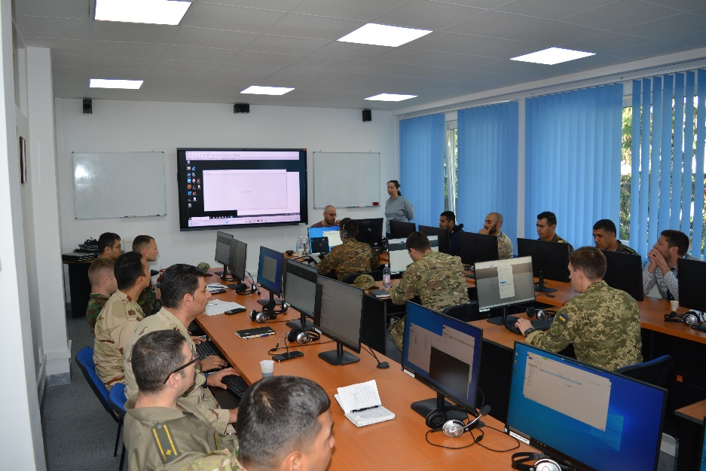
Information Security Management
Postgraduate Course - ACT 675
Student Criteria:
Officers and civilian personnel in charge with information security management and related fields
Goal:
To enhance participants’ knowledge, competence and skills in information security management.
Course Duration: 4 weeks
Curriculum:
  1. Assuring the Information Security
  2. Critical Information Infrastructure Protection
  3. Enterprise Computer Networking and Telecommunications Security
  4. Enterprise Information Security Strategies and Risk Management
  5. Managerial Communication

Slide 31
6. Information Security Management
Postgraduate Course
- accredited as “NATO APPROVED” -
(ePRIME and ETOC listed) ACT 675
Student Criteria:
Officers and civilian personnel in charge with information security management and related fields
Goal:
To enhance participants’ knowledge, competence and skills in information security management.

Slide 32
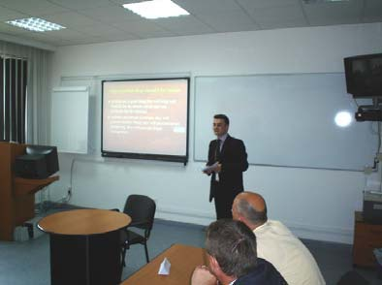
Information Security Management
Postgraduate Course
Curriculum:
  1. Assuring the Information Security
  2. Critical Information Infrastructure Protection
  3. Enterprise Computer Networking and Telecommunications Security
  4. Enterprise Information Security Strategies and Risk Management
  5. Managerial Communication
Course Duration - 4 weeks

Slide 33
Master studies program
“Organization Resources Management”
Student Criteria:
Any person who meets the conditions set by the national legislation.
Goal:
The master studies program organized by DRESMARA is aimed to provide in-depth knowledge about organization resource management and to develop knowledge and cross-curricular skills, as well as, specific cognitive skills above the level of bachelor studies.
33

Slide 34
HOW TO APPLY
FOR COURSES
1. Based on your direct request addressed to Allied Command Transformation for seats listed in ePRIME and funded by NATO.
2. Based on bilateral protocols between Romania and other states:
Documents should be sent by mail or fax by your Defense Minister to the address indicated below, via the Romanian Defense Attaché from your country /region
Address: Romania, Human Resources Management General Directorate
Fax: 004 - 021.319.58.81
Email: mcraciun@mapn.ro

Slide 35
ALUMNI
(June 2026)
Total
graduates
Foreign
graduates
TOTAL –3987 GRADUATES out of which 1027 international

Slide 36




GRADUATES’ PROFESSIONAL BACKGROUND
Ministry of National Defense (MoND)
Structures from the National Defense System,
Public Order and National Security (NDSPONS)
MoND / NDSPONS / Civilians
Civil Society
80
60
88,5%
40
8,5%
88,5%
20
3%
8,5%
3%
0

Slide 37





































1027 FOREIGN GRADUATES from 42 countries
4
2
1
13
9
5
1
3
15
18
71
4
1
9
9
4
1
2
2
7
4
28
8
29
1
57
111
23
26
15
2
173
4
23
30
1
73
69
157
7

Slide 38
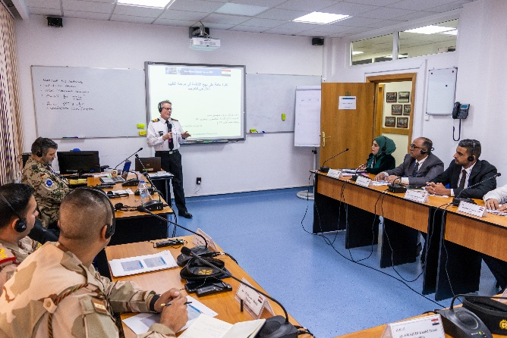
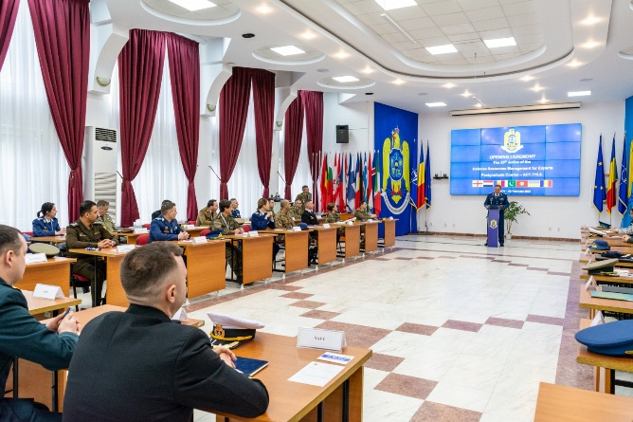
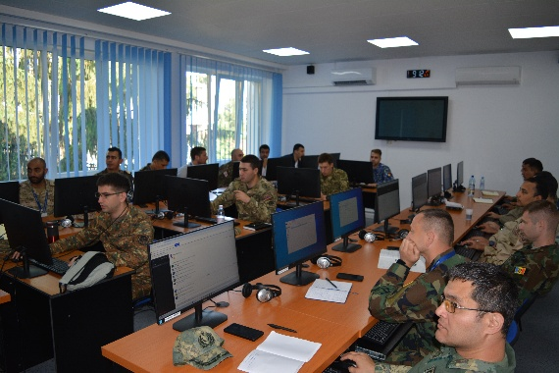
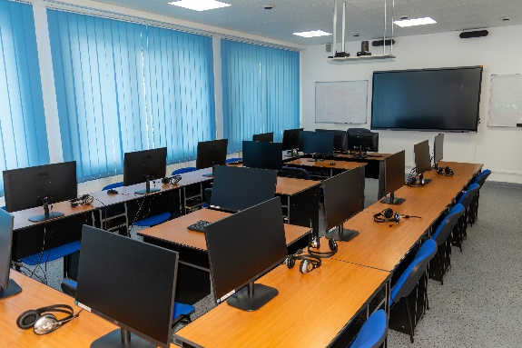
RESOURCES AND FACILITIES
EDUCATION
•Auditorium
• Lecture rooms
• Syndicate rooms
• IT laboratories
• Internet - broadband
connection
• Intranet network
• Editing facilities
• Library

Slide 39
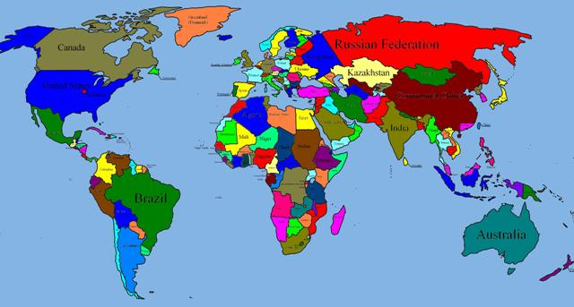
INTERNATIONAL VISITS
FROM 47 COUNTRIES
Afghanistan
Albania
Angola
Armenia
Austria
Azerbaijan
Belgium
Bosnia and Herzegovina
Bulgaria
Canada
China
Congo (DRC)
Croatia
Czech Republic
Denmark
Egypt
Finland
France
Georgia
Germany
Greece
Hungary
India
Iraq
Italy
Jordan
Kazakhstan
Latvia
Lithuania
Luxembourg
Moldova
Netherlands
North Macedonia
Poland
Portugal
Saudi Arabia
Serbia
South Africa
Spain
Sweden
Switzerland
Turkey
UK
Ukraine
USA
Vietnam
Notes:
This slide presents the international relationships of our Center.
Until now, more than 60 delegations have visited our Center. These delegations represented most of the European and North American countries. Starting with this year we established relations with some countries from Asia. The representatives from the National Defense College from India visited our Center, and the College of Defense Management also from India proposed us mutual presentations, faculty exchanges and sessions and faculty-student interaction. Also we established relations with Georgia and Azerbaijan.

Slide 40
COLLABORATION WITH OTHER INSTITUTIONS
From Romania
”Transilvania” University, Brasov
”Henri Coandă” Air Forces Academy, Brasov
”Nicolae Bălcescu” Land Forces Academy, Sibiu
”Mircea cel Bătrân” Naval Academy, Constanta
NATO HUMINT Centre of Excellence / HCOE, Oradea
Notes:
DRESMARA a dezvoltat permanent relaţiile de cooperare cu instituţii similare de învăţământ din ţară şi străinătate, cele prezentate pe slide fiind cele cu care DRESMARA cooperează cel mai mult.

Slide 41
COLLABORATION WITH OTHER INSTITUTIONS
From abroad
National Defense University /College of Information and Cyberspace, Washington D.C., USA
U.S. Naval War College, Newport, Rhode Island, USA
Faculty of National Security /War Studies University from Warsaw, Republic of Poland
Faculty of Military Leadership /University of Defence, Brno, the Czech Republic
Partnership for Peace Consortium of Defense Academies and Security Studies Institutes /”George C. Marshall European Center for Security Studies”, Federal Republic of Germany
Defense Resources Management Institute / Naval Postgraduate School, Monterey, USA
NATO School Oberammergau, Federal Republic of Germany
”Piraeus” University, Piraeus, Hellenic Republic
”Alexandru cel Bun” Military Academy of the Armed Forces from Chisinau, Republic of Moldova
Center for Integrity in the Defense Sector, Oslo, Kingdom of Norway
Notes:
DRESMARA a dezvoltat permanent relaţiile de cooperare cu instituţii similare de învăţământ din ţară şi străinătate, cele prezentate pe slide fiind cele cu care DRESMARA cooperează cel mai mult.

Slide 42
INTERNATIONAL ACTIVITIES
• Participation in GLOBAL PROGRAMMING:
Training Needs Analyses Working Groups /Training Requirements Analyses Workshops and Annual Discipline Conferences for Building Integrity (BI), Cyberspace Operations (CO) and Education, training, exercises and evaluation (ETEE)
Annual Disciplines Forum
Quality Assurance Forum
• Participation in the NATO Partnership Training and Education Centers activities:
- Annual Commandants’ Conferences (hosted by DRESMARA in 2019)
- Military Strategic Partnership Conference & Exhibition
- Working Groups (hosted by DRESMARA in 2011, 2015 and 2024)
- Marketplaces
- Train the trainer and Instructor Exchange Programs, offered by NATO School

Slide 43
INTERNATIONAL ACTIVITIES
• Participation in NATO Defence Education Enhancement Programme (DEEP), in cooperation with PfP Consortium of Defense Academies and Security Studies Institutes:
- Annual Conference NATO Clearing House on Defence Education
- Seminars and workshops in the Republic of Albania (2022/online, 2023), Republic of Armenia (2019, 2025), Republic of Azerbaijan (2-2024), Georgia (2014, 2016, 2017, 2018, 2022, 2024, 2-2025), Hashemite Kingdom of Jordan (2022, 2025), Republic of Kyrgyzstan (2019), Republic of North Macedonia (2019), Islamic Republic of Mauritania (2-2022, 2023, 2025), Republic of Moldova (2013, 2 - 2017), Mongolia (2023), Republic of Tunisia (2022)

Slide 44
INTERNATIONAL ACTIVITIES
DEEP AFGHANISTAN: Workshop for didactic training of the Afghan military and civilian personnel: Faculty Development Workshop (2016, 2 in 2018, 2019), Development curriculum for strategic master's degree workshop (2019), ”Master Instructors Program” workshop/working group (2019), Education Quality Assurance Workshop (2020, 2021, online format)
DEEP MAURITANIA: Workshop in support of the development of professional military education ”Master Instructors Program”, hosted and coordinated by DRESMARA (2024)

Slide 45
INTERNATIONAL ACTIVITIES
DEEP IRAQ:
- Foundational Faculty Development Program Workshops /FFDP, “STUDENT CENTERED ACTIVE LEARNING METHODS” in support of the Ministerial Training and Development Center (MTDC) (2022)
- Workshops in support of the development of professional military education, in the field of NATO Systems Approach to Training, for military and civilian personnel from specialized educational institutions, in cooperation with NATO IS and NATO Mission Iraq (NMI), hosted and coordinated by DRESMARA (2022 and 2023)
- Workshop in support of the development of professional military education "Master Instructors Program", hosted and coordinated by DRESMARA (2022)
- Faculty foundational development workshop for the instructors and academic staff working with the Iraqi Defence University for Higher Military Studies (DUFHMS) at the “G.S. Rakovski” National Defence College in Sofia, Bulgaria (2023)
- Workshops in support of the development of professional military education, in the field of NATO Systems Approach to Training and Global Programming, for civilian personnel from MTDC, in cooperation with NATO IS and NATO Mission Iraq (NMI), organized and hosted by DRESMARA (2025)

Slide 46
INTERNATIONAL ACTIVITIES
• Participation in the PfP Consortium of Defense Academies and Security Studies Institutes activities:
- Advanced Distributed Learning Working Groups (ADL WGs)
- Education Development Working Group
• International Scientific Conference "Defense Resources Management in the 21st Century" - 19 editions
• Seminars carried out by international experts within postgraduate courses
• Visits by foreign delegations

Slide 47
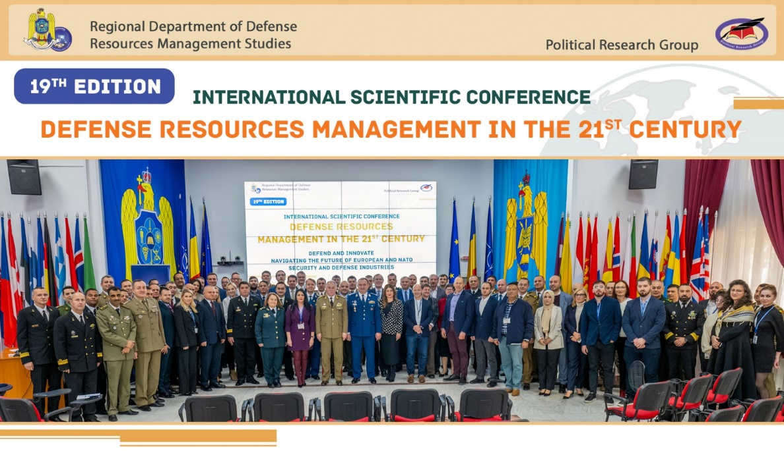
SCIENTIFIC RESEARCH
INTERNATIONAL SCIENTIFIC CONFERENCE
“Defense Resources Management in the 21-st Century”
Moto:
Defence Resources Management
in the current volatile global context
  20 editions, 799 papers with 956 authors/experts from over 18 countries
  indexed in internationally recognized databases: EBSCO, ProQuest and C.E.E.O.L.
  co-organizers: Non-Governmental Association "Political Research Group", Faculty of National Security/War Studies University from Warsaw, Republic of Poland, Faculty of Military Leadership/University of Defense, Brno, Czech Republic and "Alexandru cel Bun" Military Academy of the Armed Forces from Chisinau, Republic of Moldova
  partners: Military Sciences Section of the Romanian Academy of Scientists, NATO HUMINT Center of Excellence, Oradea and "Transylvania" University/Brasov
  scientific areas: Transatlantic Cooperation, Defense Economics, Social Sciences, Military Strategies and Defense Planning, Management Theories and Practices, Information Science, Military Affairs and Security

Slide 48
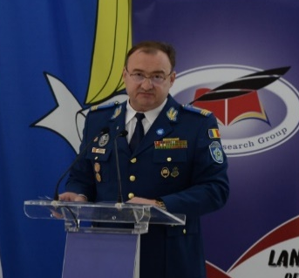
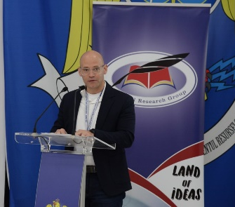
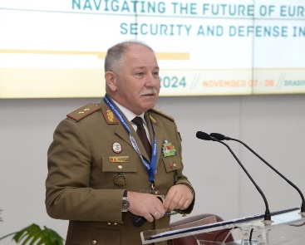
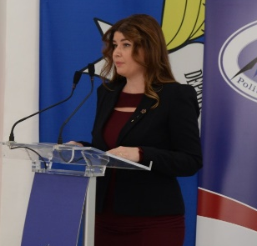
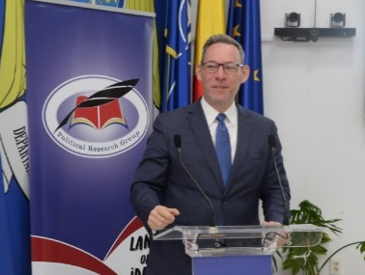
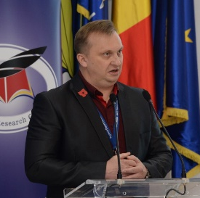
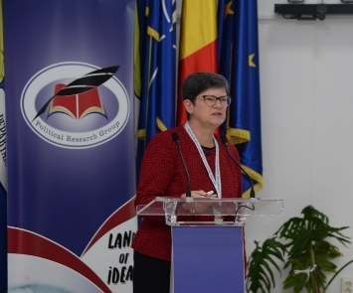
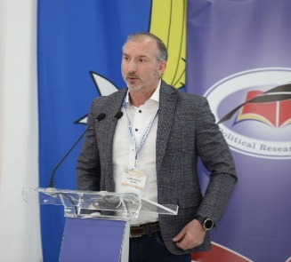
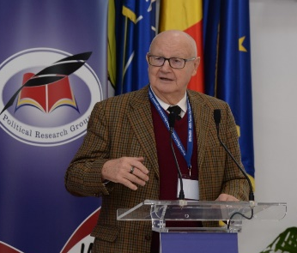
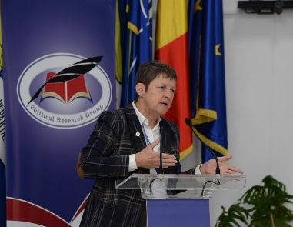
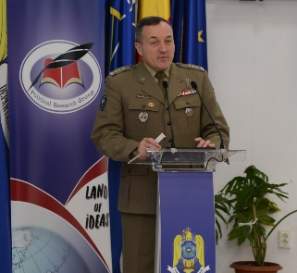
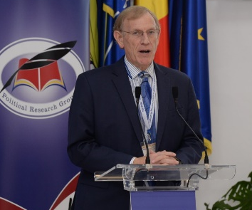
SCIENTIFIC RESEARCH
INTERNATIONAL SCIENTIFIC CONFERENCE
“Defense Resources Management in the 21-st Century”
  Keynote speakers from:
European Defense Agency/EU
RAND Corporation, USA
Brookings Institution, USA
Center for European Policy Analysis (CEPA), USA
Geopolitical Futures , USA
Systems Planning and Analysis, Inc., USA
Warsaw Security Forum
Naval Postgraduate School, USA
Naval War College, USA
Office of Foreign Investment Review/Department of Defense, USA
University of Piraeus, Greece
War Studies University, Poland
University of Defense, Czech Republic
Military Academy of the Armed Forces, the Republic of Moldova
Ministry of National Defense
National School of Political Studies and Public Administration
„Transilvania” University, Brasov, Romania
Political Research Group, Romania
National Defense University, USA
Mach Industries, USA

Slide 49
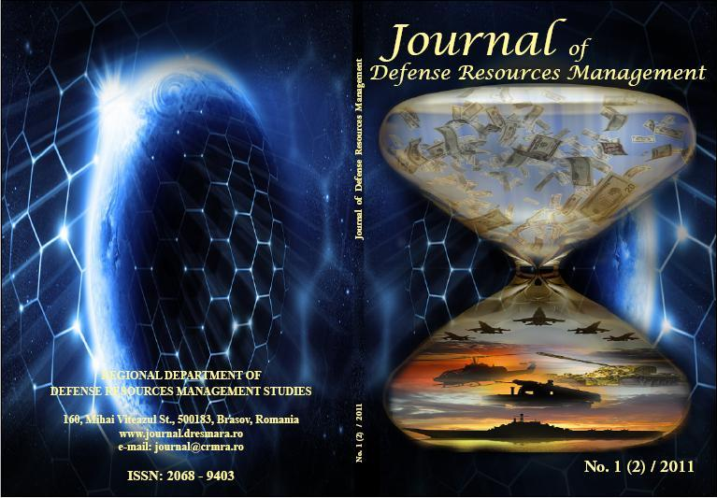
SCIENTIFIC RESEARCH
Journal of Defense Resources Management (JoDRM)
ISSN: 2068-9403, eISSN: 2247-6466
509 articles published by 465 foreign authors and 372 Romanian authors in 32 issues
Indexed in the following prestigious international
databases:
1. Ulrich’s Global Serials Directory
2. Directory of Open Access Journals (DOAJ)
3. EBSCO - International Security & Counter Terrorism Reference Centre
4. ProQuest
5. Central and Eastern European Online Library (C.E.E.O.L.)
6. WORLDCAT
7. Karlsruhe Virtual Catalog (KVK)
8. Cabell’s Directories
9. Cengage learning
10. European Reference Index for the Humanities and Social Sciences
(ERIH PLUS)

Slide 50

CONTACT DETAILS:
Address: 160 Mihai Viteazul, Brasov 500183, County of Brasov, ROMANIA
Telephone: +40 268 401800
Fax: +40 268 401802
Email: contact.dresmara@mapn.ro
Web site: www.dresmara.ro
Notes:
50

